Slide 1

Hive
Outline :
About Hive.
Architecture
Basic Commands
By: Vishal Ramane - 2019430010
Shreyam Shah - 2019430011

Slide 2
Hive
WHAT IS HIVE?
An ETL and Data warehouse system built to work on Hadoop.
Used to query and manage large datasets residing in distributed storage.
Provides a mechanism to give structure to the data in Hadoop and,
To query that data using a SQL-like language called HiveQL (HQL).
WHY HIVE ?
It makes job easy for performing operations like:
Analysis of huge datasets.
Ad-hoc queries.
Data encapsulation.
Tables in HIVE are similar to tables in a relational database.
Transition from SQL to HiveQL is easy.
HQL allows to write Custom MapReduce Framework for sophisticated tasks.

Slide 3
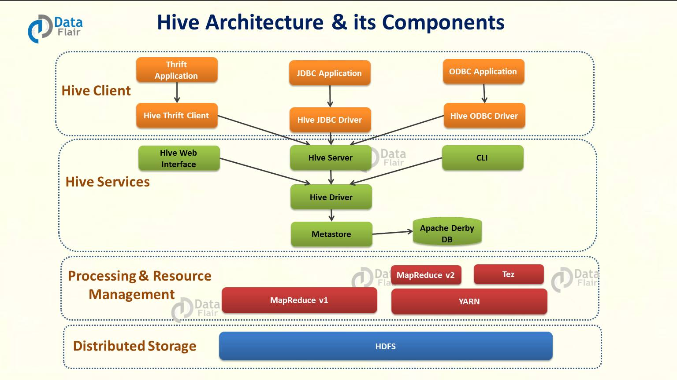
Hive Architecture
Provides 3 Drivers.
Thrift , JDBC,ODBC
Which are used to communicate with applications built using any language.
Thrift :
Interface definition language.
Binary communication protocol.
define and create services for numerous languages.
JDBC:
allows Java applications to connect to Hive.
class apache.hadoop.hive.jdbc.HiveDriver
ODBC:
allows applications that support ODBC protocol to connect to Hive.
Uses Thrift to communicate with Hive Driver.
CLI :
Default shell that Hive provides.
Can execute Hive queries and command directly.
Hive Server:
built on Apache Thrift
Allows different clients to submit requests and retrieve the final result.
Hive Driver :
Responsible for receiving the queries from client drivers.
driver passes the query to the compiler.
Compiler :
Parsing
type checking
semantic analysis (using metastore)
Optimizer :
optimized logical plan in the form of a DAG of MapReduce and HDFS tasks.
Executor:
execution engine executes these tasks,
in the order of their dependencies.
Hive Web Interface:
provides web based GUI for executing Hive queries and commands.
Metastore :
central repository of Hive Metadata.
stores the metadata for Hive tables and relations.
Schema and Locations etc

Slide 4
Basic Hive Commands
DDL
Create Database
Drop Database
Create/Alter/Drop Table
Views
DML
Load
Select
Where
Group By
Having
Limit

Slide 5
Basic Hive Commands
Create database: Creates a database in Hive
Syntax: CREATE DATABASE|SCHEMA [IF NOT EXISTS] <database name>;
Show database: Command shows the existing databases in Hive
Syntax: SHOW DATABASES;

Slide 6
Basic Hive Commands
Create table:
Syntax: CREATE [TEMPORARY] [EXTERNAL] TABLE [IF NOT EXISTS] [db_name.] table_name
[(col_name data_type [COMMENT col_comment], ...)]
[COMMENT table_comment]
[ROW FORMAT row_format]
[STORED AS file_format]
Load: Loads the data into the table.
Syntax: LOAD DATA [LOCAL] INPATH 'filepath' [OVERWRITE] INTO TABLE tablename
[PARTITION (partcol1=val1, partcol2=val2 ...)]

Slide 7
Thank You!!

Slide 8
References
https://www.edureka.co/blog/hive-commands-with-examples
https://data-flair.training/blogs/apache-hive-architecture/
https://www.tutorialspoint.com/hive/hive_create_database.htm

